Slide 1

Computer Organization And Architecture
CPEN6260010 (2 Credits)
S6-S7 Memory
Dr. Endra, S.Kom., M.T.
D2395

Slide 2
Learning Outcomes
LO-2: Explain the fundamental structure and operation of the Central Processing Unit (CPU), including the roles and interactions of its main components (e.g., ALU, control unit, registers) during instruction execution.
LO-4: Analyze the characteristics (e.g., speed, cost, capacity) and performance implications of different levels within the memory hierarchy (e.g., cache, main memory, secondary storage).

Slide 3
OUTLINE
Introduction
Types of Memory
The Memory Hierarchy
Cache Memory
Virtual Memory
Real-World Examples of Memory Management

Slide 4
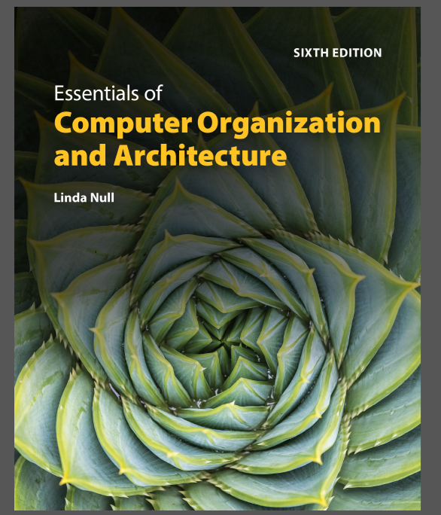
TEXTBOOK
Linda Null. (2023). Essentials of Computer Organization and Architecture with Navigate Advantage Access. Jones & Bartlett Learning. 25 Mall Road Burlington, MA 01803. ISBN: 1284259439.

Slide 5
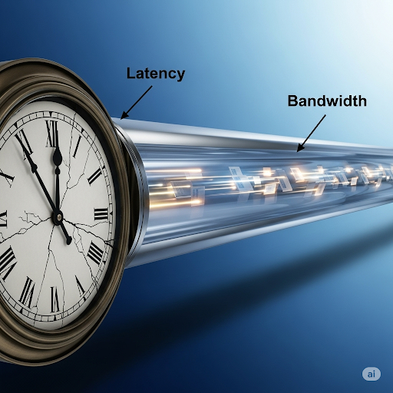
Introduction
Memory Basics: Latency and Bandwidth
Memory is a crucial component of any computer system, and its performance is measured by several key factors. Latency is the time it takes for a requested memory access to be completed. Bandwidth is the number of bits or bytes that can be transferred from memory in one second. We also classify memory based on whether it is static (retains its state as long as power is on) or dynamic (requires constant refreshing to maintain its state), and whether it is volatile (loses contents when power is off) or nonvolatile.

Slide 6
Types of Memory
Random Access Memory (RAM)
Memory can be classified as either Random Access Memory (RAM) or Sequential Access Memory. RAM is memory in which each memory cell has a unique address and can be accessed in any order at a constant time. There are two main types of RAM:
SRAM (Static RAM): Fast, expensive, and uses a flip-flop to store each bit.
DRAM (Dynamic RAM): Slower, less expensive, and uses a capacitor to store each bit, which requires periodic refreshing to prevent data loss.
The goal of the memory hierarchy is to give the best performance at the lowest cost by leveraging both types.

Slide 7
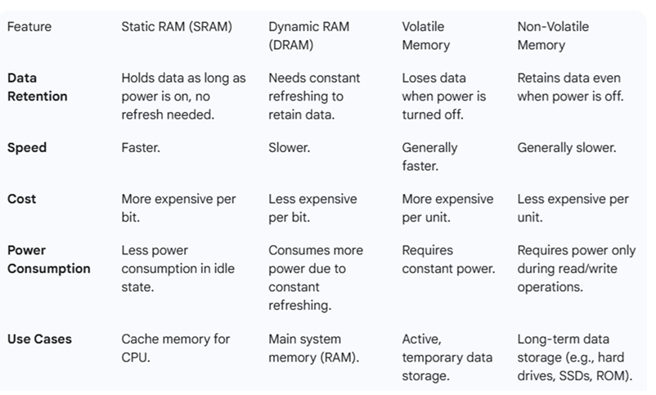
Types of Memory
Memory Type Comparison

Slide 8
The Memory Hierarchy
The Memory Hierarchy
The memory hierarchy is a tiered approach to memory design that balances cost and performance. It consists of multiple levels, ranging from small, fast, and expensive memory at the top to large, slow, and inexpensive memory at the bottom. The goal is to maximize temporal locality (the tendency to access the same data again soon) and spatial locality (the tendency to access data near recently accessed data). By doing so, a program can find most of the data it needs in the faster, closer memory tiers.

Slide 9
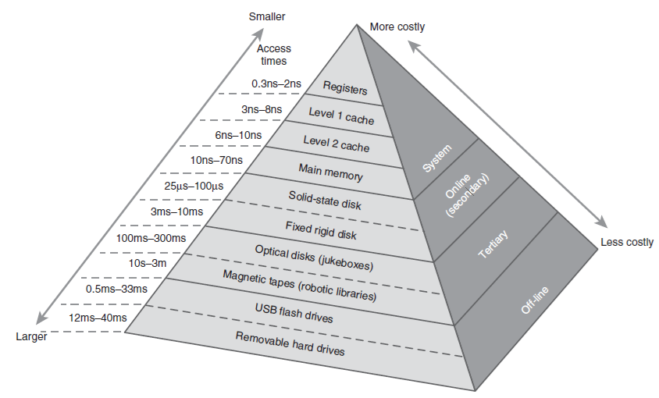

The Memory Hierarchy
The Memory Hierarchy

Slide 10
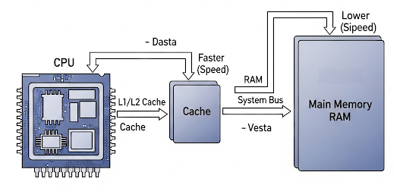
Cache Memory
Cache Memory: The First Tier
Cache memory is a small, high-speed memory that stores copies of data from frequently used main memory locations. When the CPU needs data, it first checks the cache. This is called a cache hit if the data is found and a cache miss if it is not. The hit rate is the percentage of memory accesses that are satisfied by the cache.

Slide 11
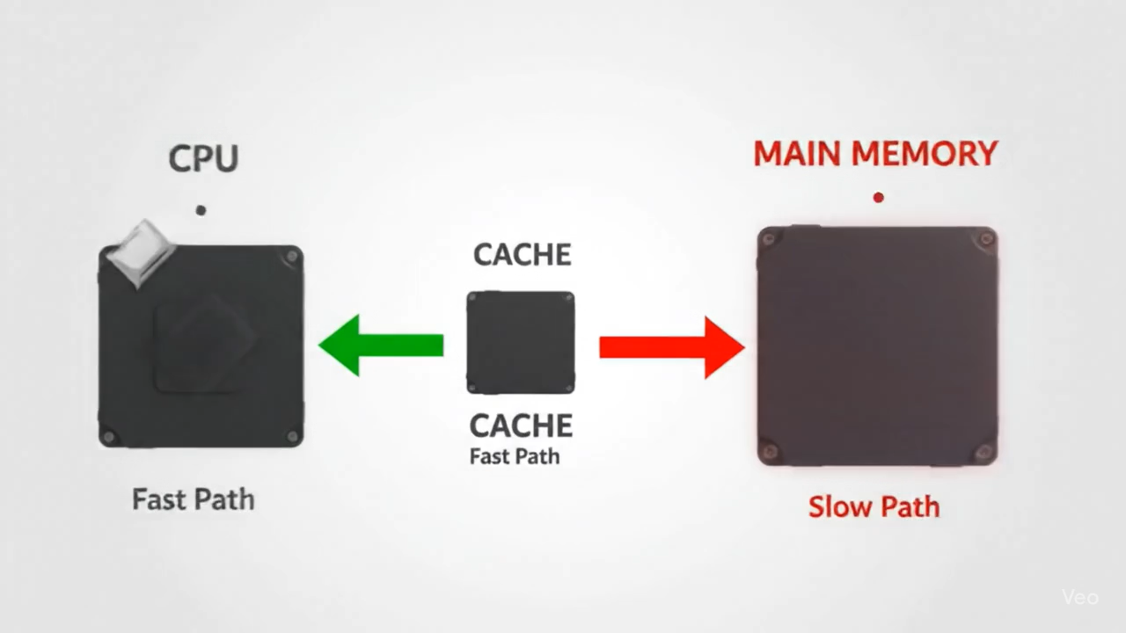
Cache Memory
Cache Memory: The First Tier

Slide 12
Cache Memory
Cache Mapping Schemes
A cache mapping scheme determines where a block of main memory can be stored in the cache. The three main schemes are:
Direct Mapped: Each memory block has only one possible location in the cache. It is simple but can suffer from high conflict misses.
Fully Associative: A memory block can be placed in any available location in the cache. This is very flexible but requires complex and expensive hardware to search all cache locations in parallel.
Set-Associative: A compromise between the two, where a memory block can be placed in any location within a specific, predefined set of cache lines. This offers a good balance of performance and complexity.

Slide 13
Cache Memory
Cache Replacement Algorithms
When a cache miss occurs and the cache is full, a replacement algorithm must decide which existing block to replace. The goal is to choose a block that is least likely to be needed again soon. Common algorithms include:
Random: A random block is selected for replacement.
FIFO (First-In, First-Out): The block that has been in the cache the longest is replaced.
LRU (Least Recently Used): The block that was last accessed the longest time ago is replaced.
LFU (Least Frequently Used): The block with the fewest hits is replaced.

Slide 14
Cache Memory
Cache Write Policies
Another key design decision for cache is the write policy, which determines when a modified block in the cache is written back to main memory.
Write-Through: Updates are written to both the cache and main memory simultaneously. This ensures main memory is always consistent but generates a lot of bus traffic.
Write-Back: Updates are written only to the cache, and a 'dirty bit' is set to indicate the block has been modified. The update is written back to main memory only when the block is chosen for replacement. This reduces bus traffic but can lead to temporary data inconsistency between cache and main memory.

Slide 15
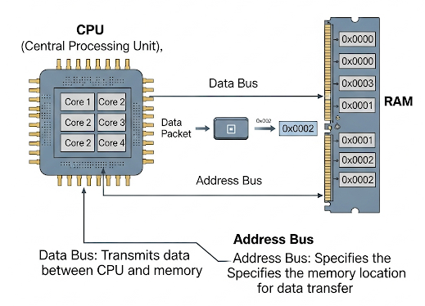
Cache Memory
Cache Write Policies

Slide 16
Cache Memory
Cache Write Policies
Another key design decision for cache is the write policy, which determines when a modified block in the cache is written back to main memory.
Write-Through: Updates are written to both the cache and main memory simultaneously. This ensures main memory is always consistent but generates a lot of bus traffic.
Write-Back: Updates are written only to the cache, and a 'dirty bit' is set to indicate the block has been modified. The update is written back to main memory only when the block is chosen for replacement. This reduces bus traffic but can lead to temporary data inconsistency between cache and main memory.

Slide 17
Virtual Memory
Virtual Memory: Expanding RAM
Virtual memory is a memory management technique that uses a hard disk as an extension of main memory (RAM). The objective of virtual memory is to increase the available address space a process can use, enabling a computer to run programs that are larger than the physical memory available. This makes it easier for programmers as they no longer have to worry about physical memory limitations. The most common way to implement virtual memory is through a process called paging. Key terms for paging include:
Virtual Address: The logical address used by a program.
Physical Address: The actual address in physical memory.
Page Table: A table in main memory that maps virtual page numbers to physical page frame numbers.
Page Fault: An event that occurs when a requested page is not in main memory and must be copied from disk.

Slide 18
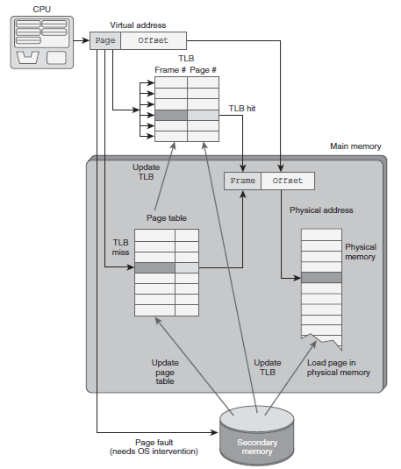
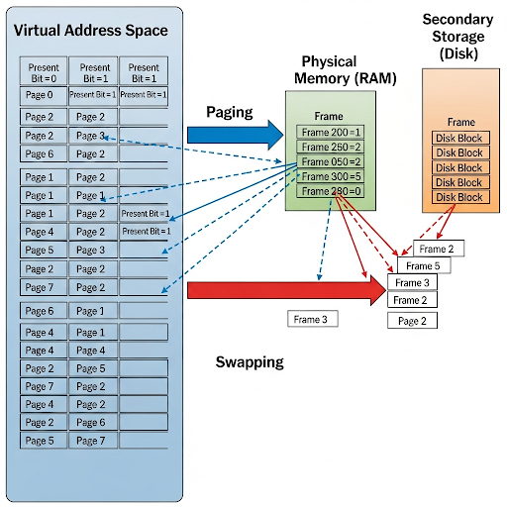

Virtual Memory
Virtual Memory: Expanding RAM

Slide 19
Real -World Examples of Memory Management
Real-World Memory Management
In modern computer systems, memory management is a complex, hierarchical process handled by the operating system and dedicated hardware like the Memory Management Unit (MMU).
Intel Core i9: This architecture uses three levels of cache: L1, L2, and L3. The L1 cache is split into a separate instruction cache and a data cache, each with its own Translation Look-aside Buffer (TLB). These caches use various forms of set-associative mapping, with L1 using 8-way, L2 using 16-way, and L3 using 11-way set-associative mapping.
MIPS: The MIPS architecture uses an on-chip MMU to map virtual addresses to physical ones. Its caches are initialized by boot code. MIPS also has a software- managed TLB and supports both big-endian and little-endian formats.

Slide 20
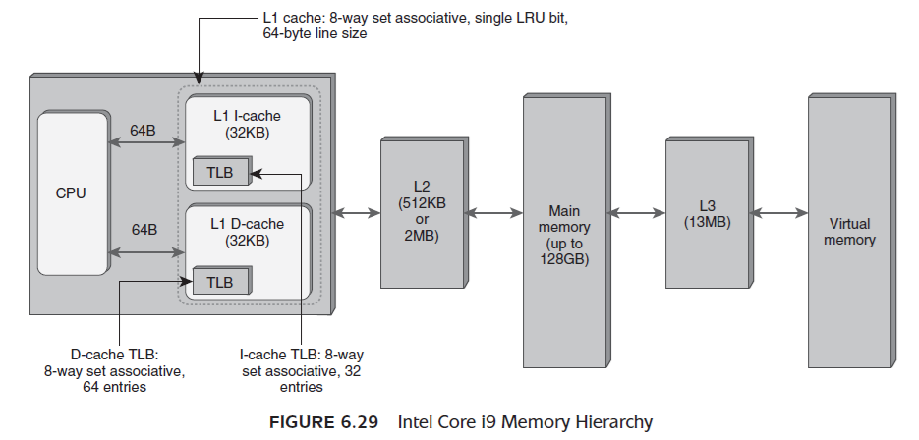
Real-World Examples of Memory Management
Real-World Memory Management

Slide 21
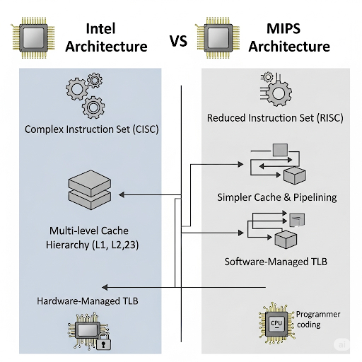
Real -World Examples of Memory Management
Real-World Memory Management

Slide 22
Evaluation
Session 6-7 Exercises
Explain the primary goals of the memory hierarchy.
How many address bits are needed for all memory if you have a 4M×16 memory that is byte addressable?
A direct mapped cache has 8 blocks. The following memory block numbers are referenced: 0, 1, 13, 2, 8, 0, 14, 1. For each memory reference, indicate whether it is a hit or a miss.
A fully associative cache has 4 blocks. Show how the memory block references from problem 3 would be handled.
Suppose a 4-way set associative cache has 8 blocks. How would the memory block references from problem 3 be handled?
Explain the difference between a write-through and a write-back cache.

Slide 23
Reference
Linda Null. (2023). Essentials of Computer Organization and Architecture with Navigate Advantage Access. Chapter 6: Memory. 25 Mall Road Burlington, MA 01803. ISBN: 1284259439.

Slide 24


